Slide 1
MSDM 5003 Lecture 13 30 November 2021 Linear Regression
Reference:
Gareth James, Daniela Witten, Trevor Hastie, Robert Tibshirani, “An Introduction to Statistical Learning: with Applications in R”, 2nd Edition (Springer) Ch. 3
Christopher Bishop, “Pattern Recognition and Machine Learning”, 2006 (Springer) Ch. 3
Acknowledgement: Prof Dong XIA, instructor of MSDM 5054

Slide 2
3. Linear Regression
3.1 Simple linear regression
3.6 More about prediction
3.2 Multiple linear regression
3.7 Superiority of LSE
3.3 Least squares estimation (LSE)
3.8 Assessing the regression model
3.4 Statistical properties of LSE
3.9 Variable selection
3.5 ANOVA
3.10 Comparison with KNN
2

Slide 3
3.0 Introduction
Most illustrative on various important issues: fitting, prediction, model checking, …
3

Slide 4
3.0 Introduction
Formulation
General linear regression model
Goal
4

Slide 5
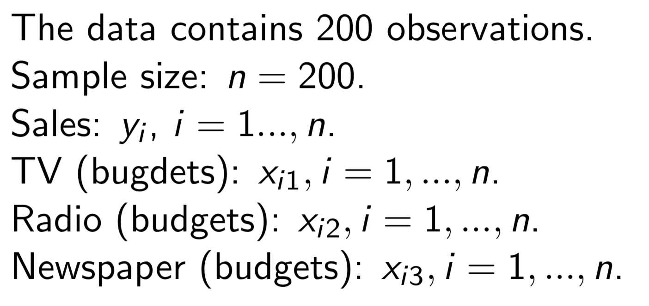
3.0 Introduction
Example: advertising data
5

Slide 6
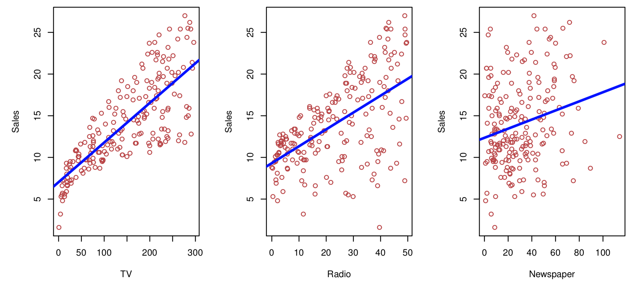
3.0 Introduction
Example: advertising data
6

Slide 7
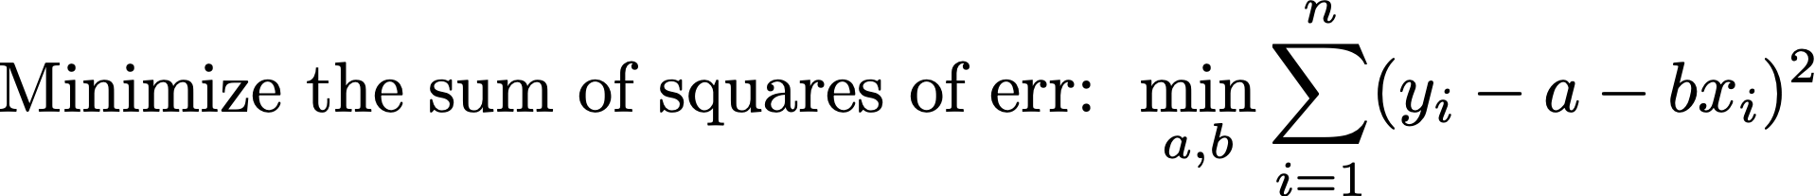
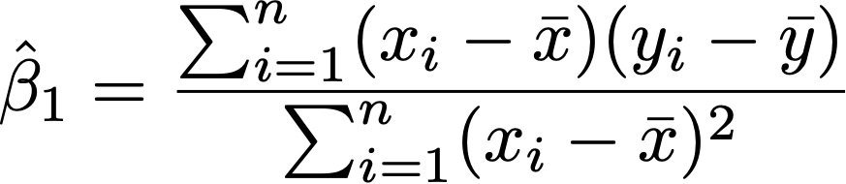

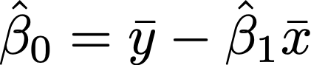
3.1 Simple Linear Regression
Simple linear regression
7

Slide 8
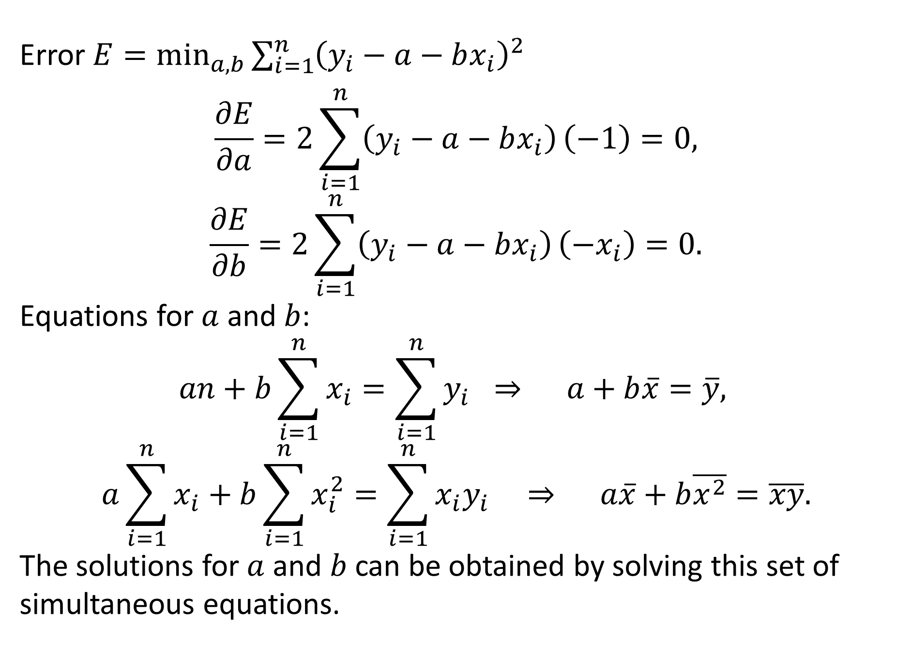

Derivation of ${\hat{β}}_{1}$ and ${\hat{β}}_{0}$
Error $E=\min_{a,b}{\sum_{i=1}^{n}{{\left(y_{i}−a−bx_{i}\right)}^{2}}}$
$$\frac{∂E}{∂a}=2\sum_{i=1}^{n}{\left(y_{i}−a−bx_{i}\right)}\left(−1\right)=0,$$
$$\frac{∂E}{∂b}=2\sum_{i=1}^{n}{\left(y_{i}−a−bx_{i}\right)}\left(−x_{i}\right)=0.$$
Equations for $a$ and $b$:
$$an+b\sum_{i=1}^{n}{x_{i}}=\sum_{i=1}^{n}{y_{i}} ⇒ a+b\overline{x}=\overline{y},$$
$$a\sum_{i=1}^{n}{x_{i}}+b\sum_{i=1}^{n}{x_{i}^{2}}=\sum_{i=1}^{n}{x_{i}y_{i}} ⇒ a\overline{x}+b\overline{x^{2}}=\overline{xy}.$$
The solutions for $a$ and $b$ can be obtained by solving this set of simultaneous equations.

Slide 9
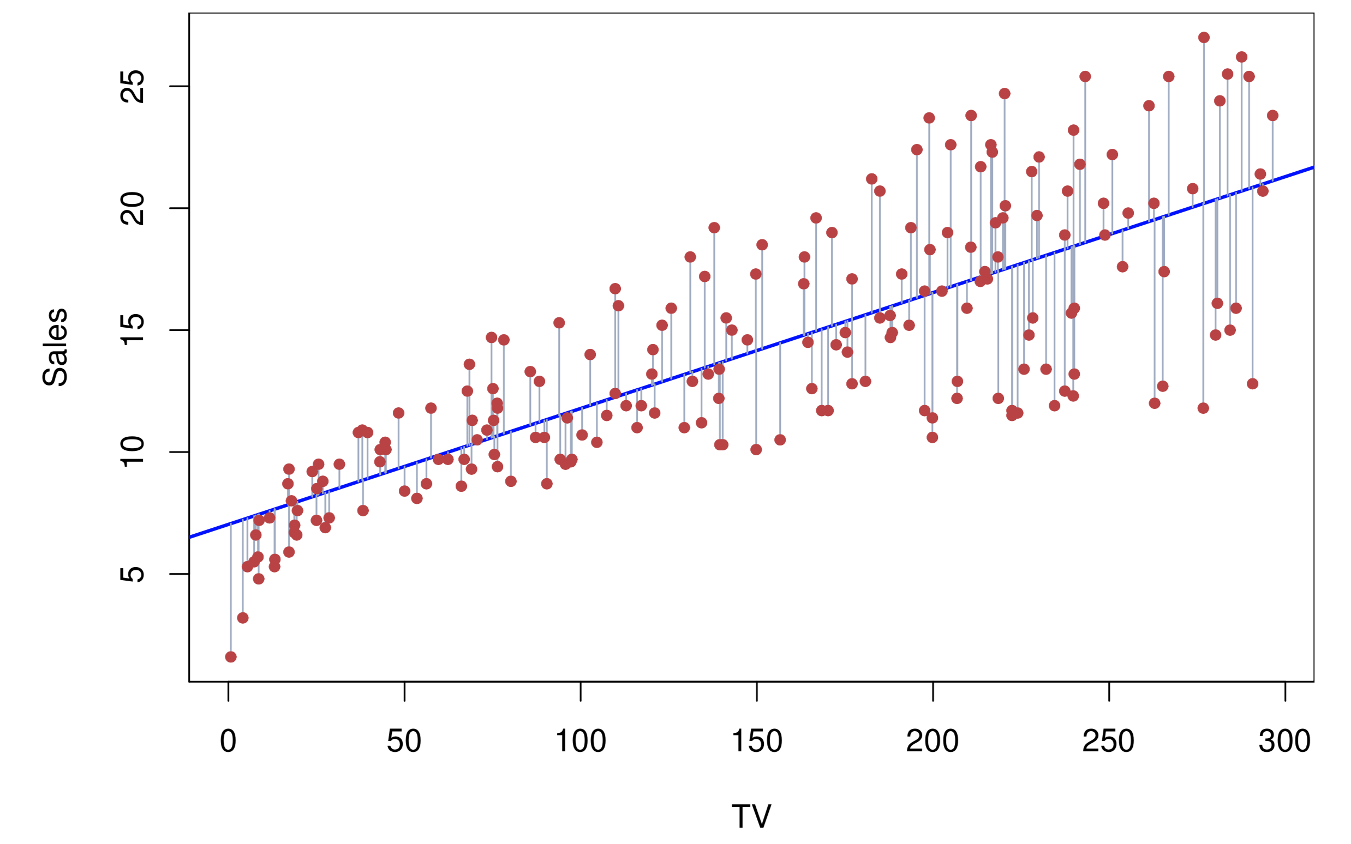
3.1 Simple Linear Regression
Example: advertising data
9

Slide 10
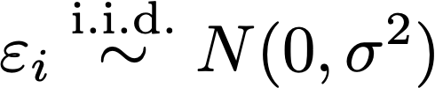
3.1 Simple Linear Regression
Statistical Inference
Goal
Assumption
The random error terms are independent and have identical normal distributions.
10

Slide 11
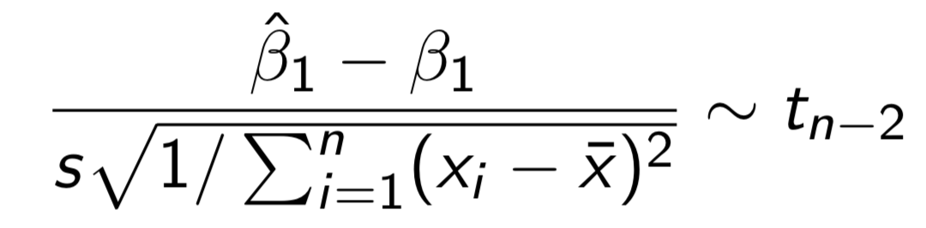
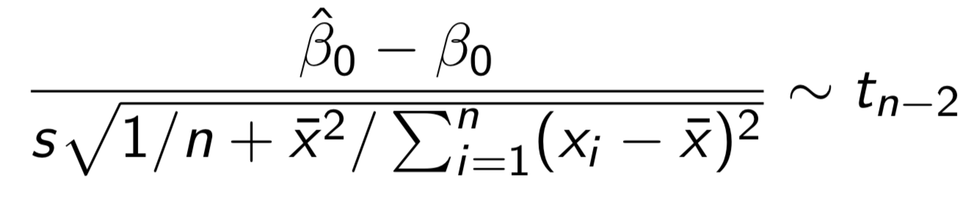
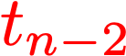
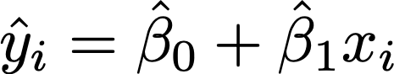
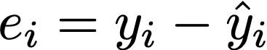
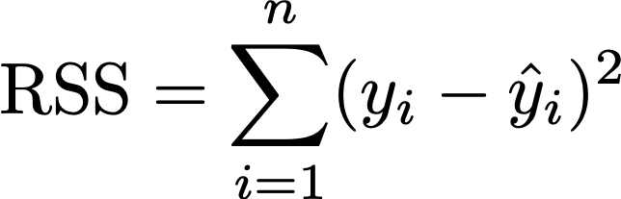
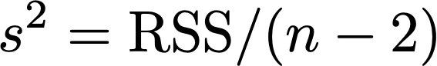
3.1 Simple Linear Regression
Statistical Inference
Theorem
This theorem is a special case of the Theorem of LSE in Section 3.4.
Student t distribution
https://en.wikipedia.org/wiki/Student%27s_t-distribution
Fitted value
Residual
Residual sum of squares
11
Chapter 3. Linear Regression

Slide 12
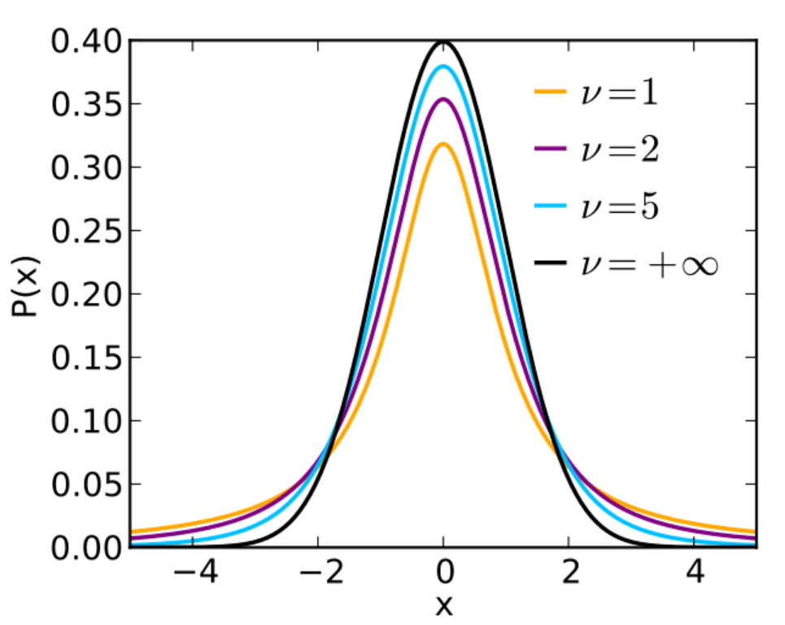
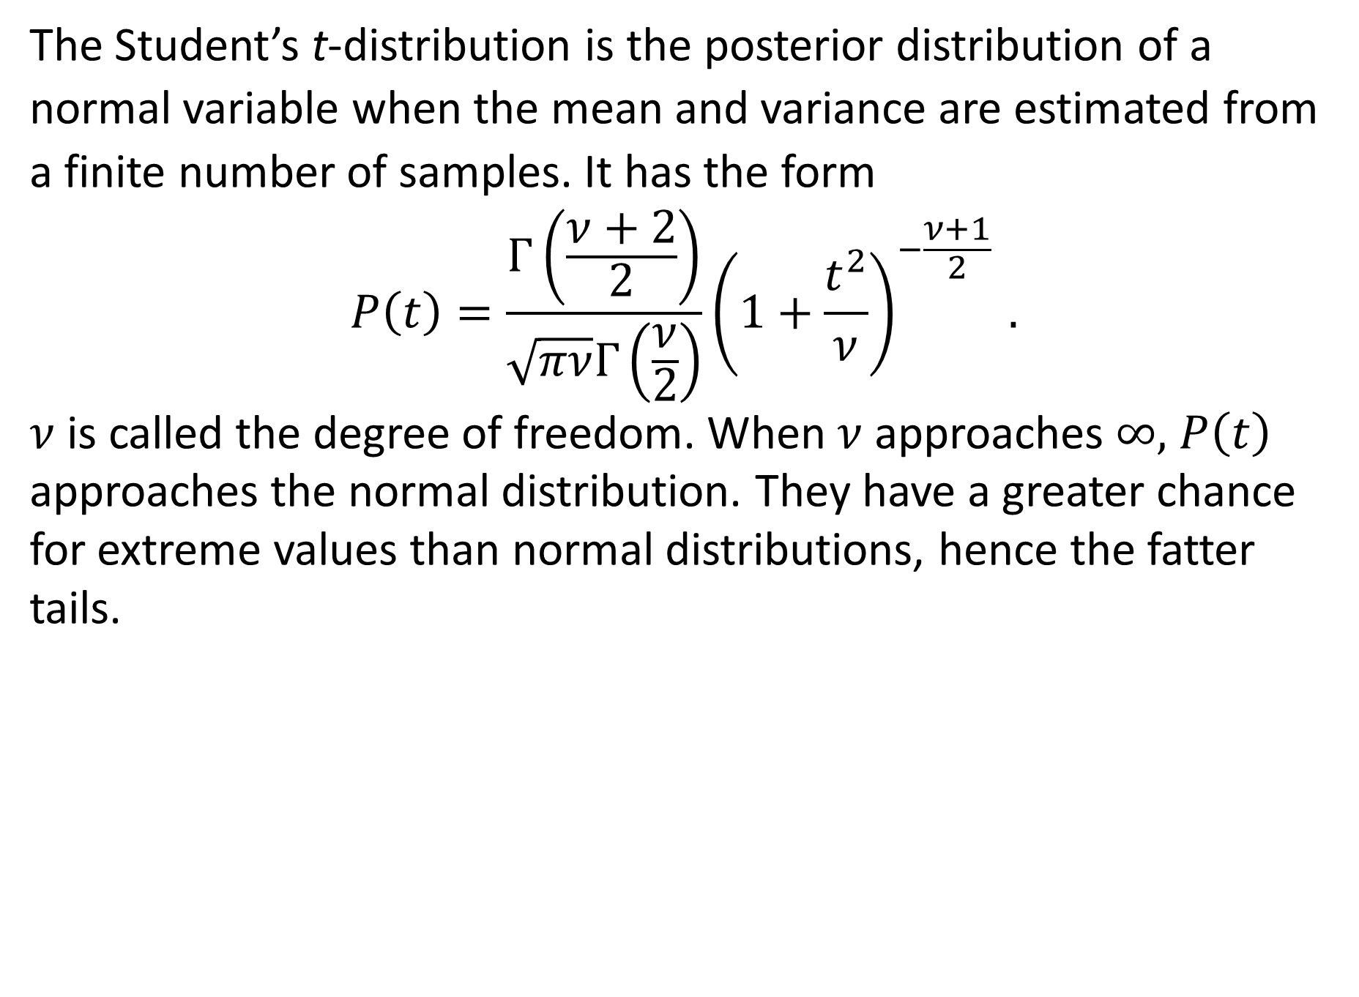
Student’s t-Distribution
The Student’s t-distribution is the posterior distribution of a normal variable when the mean and variance are estimated from a finite number of samples. It has the form
$$P\left(t\right)=\frac{Γ\left(\frac{ν+2}{2}\right)}{\sqrt{πν}Γ\left(\frac{ν}{2}\right)}{\left(1+\frac{t^{2}}{ν}\right)}^{−\frac{ν+1}{2} }.$$
$ν$ is called the degree of freedom. When $ν$ approaches $∞,$ $P\left(t\right)$ approaches the normal distribution. They have a greater chance for extreme values than normal distributions, hence the fatter tails.

Slide 13
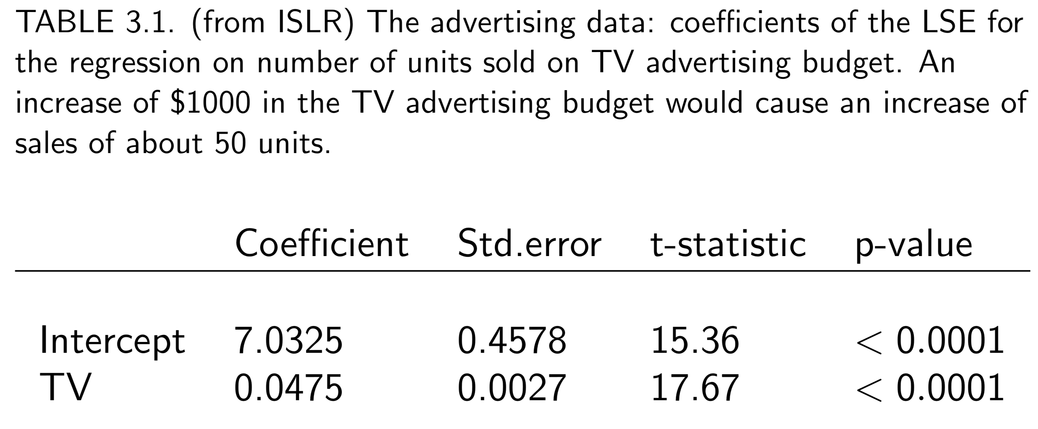

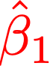
3.1 Simple Linear Regression
Statistical Inference
Example
Smaller p-value indicates that this coefficient is more likely non-zero.
13

Slide 14
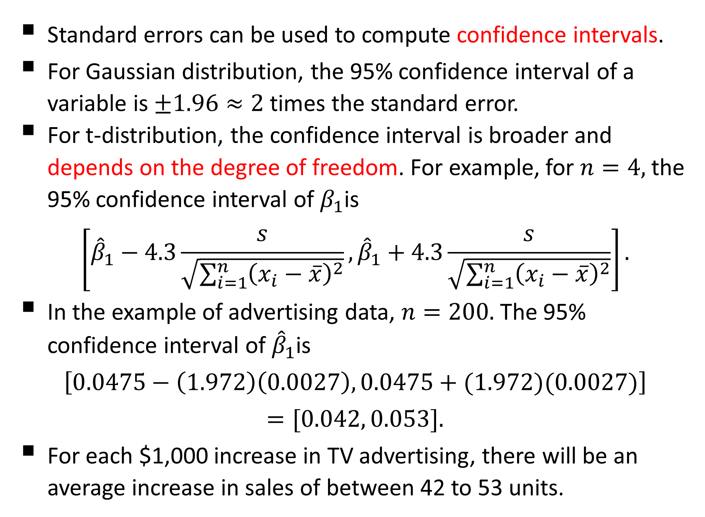
Confidence Intervals
Standard errors can be used to compute confidence intervals.
For Gaussian distribution, the 95% confidence interval of a variable is $±1.96≈2$ times the standard error.
For t-distribution, the confidence interval is broader and depends on the degree of freedom. For example, for $n=4,$ the 95% confidence interval of $β_{1}$is
$$\left[{\hat{β}}_{1}−4.3\frac{s}{\sqrt{\sum_{i=1}^{n}{{\left(x_{i}−\overline{x}\right)}^{2}}}},{\hat{β}}_{1}+4.3\frac{s}{\sqrt{\sum_{i=1}^{n}{{\left(x_{i}−\overline{x}\right)}^{2}}}}\right].$$
In the example of advertising data, $n=200.$ The 95% confidence interval of ${\hat{β}}_{1}$is
$$\left[0.0475−\left(1.972\right)\left(0.0027\right), 0.0475+(1.972)(0.0027)\right]$$
$$=[0.042, 0.053].$$
For each $1,000 increase in TV advertising, there will be an average increase in sales of between 42 to 53 units.

Slide 15
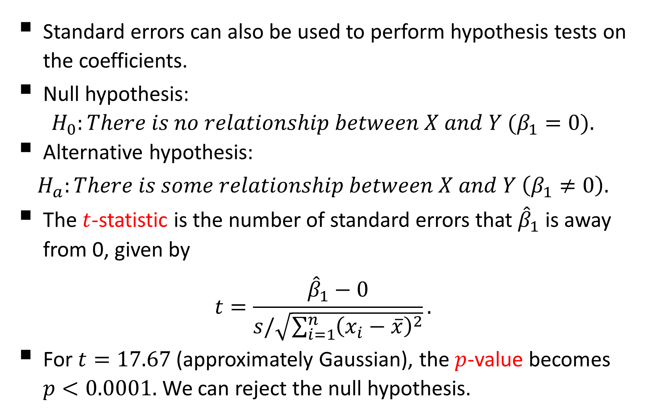
Hypothesis Tests
Standard errors can also be used to perform hypothesis tests on the coefficients.
Null hypothesis:
$$H_{0}:There is no relationship between X and Y (β_{1}=0).$$
Alternative hypothesis:
$$H_{a}:There is some relationship between X and Y \left(β_{1}≠0\right).$$
The $t$-statistic is the number of standard errors that ${\hat{β}}_{1}$ is away from 0, given by
$$t=\frac{{\hat{β}}_{1}−0}{s/\sqrt{\sum_{i=1}^{n}{{\left(x_{i}−\overline{x}\right)}^{2}}}}.$$
For $t=17.67$ (approximately Gaussian), the $p$-value becomes $p<0.0001.$ We can reject the null hypothesis.

Slide 16
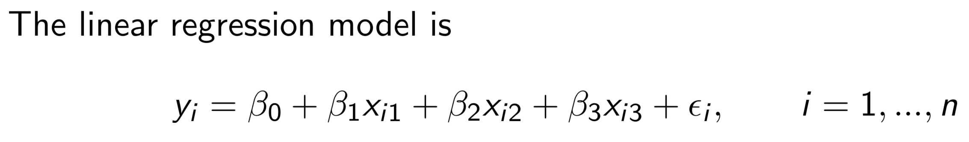
3.2 Multiple Linear Regression
General linear regression model
Example
Consider the advertising data with three covariates: TV, radio, newspapers.
The number of covariates p=3
16
Chapter 3. Linear Regression

Slide 17
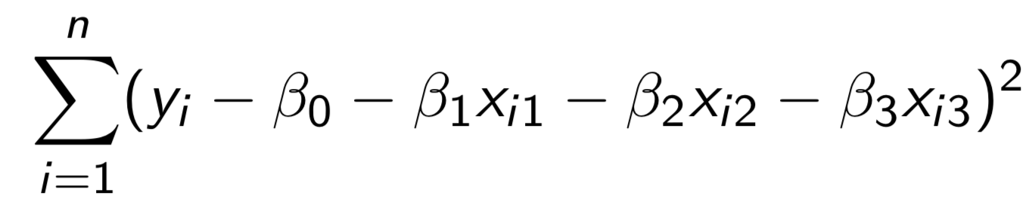
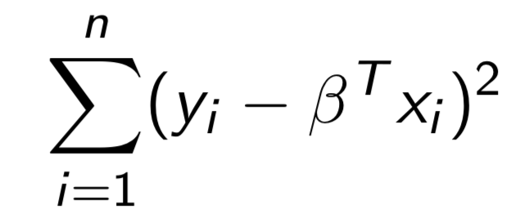

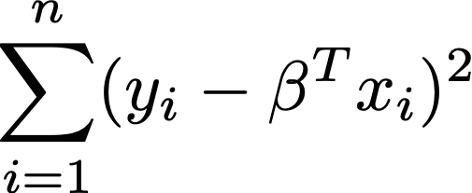
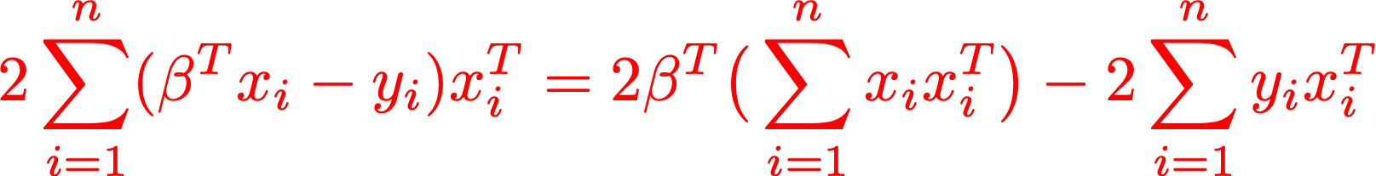

3.2 Multiple Linear Regression
Example: advertising data
Derivative (formally called gradient) of
Setting the gradient zero and solve
17

Slide 18
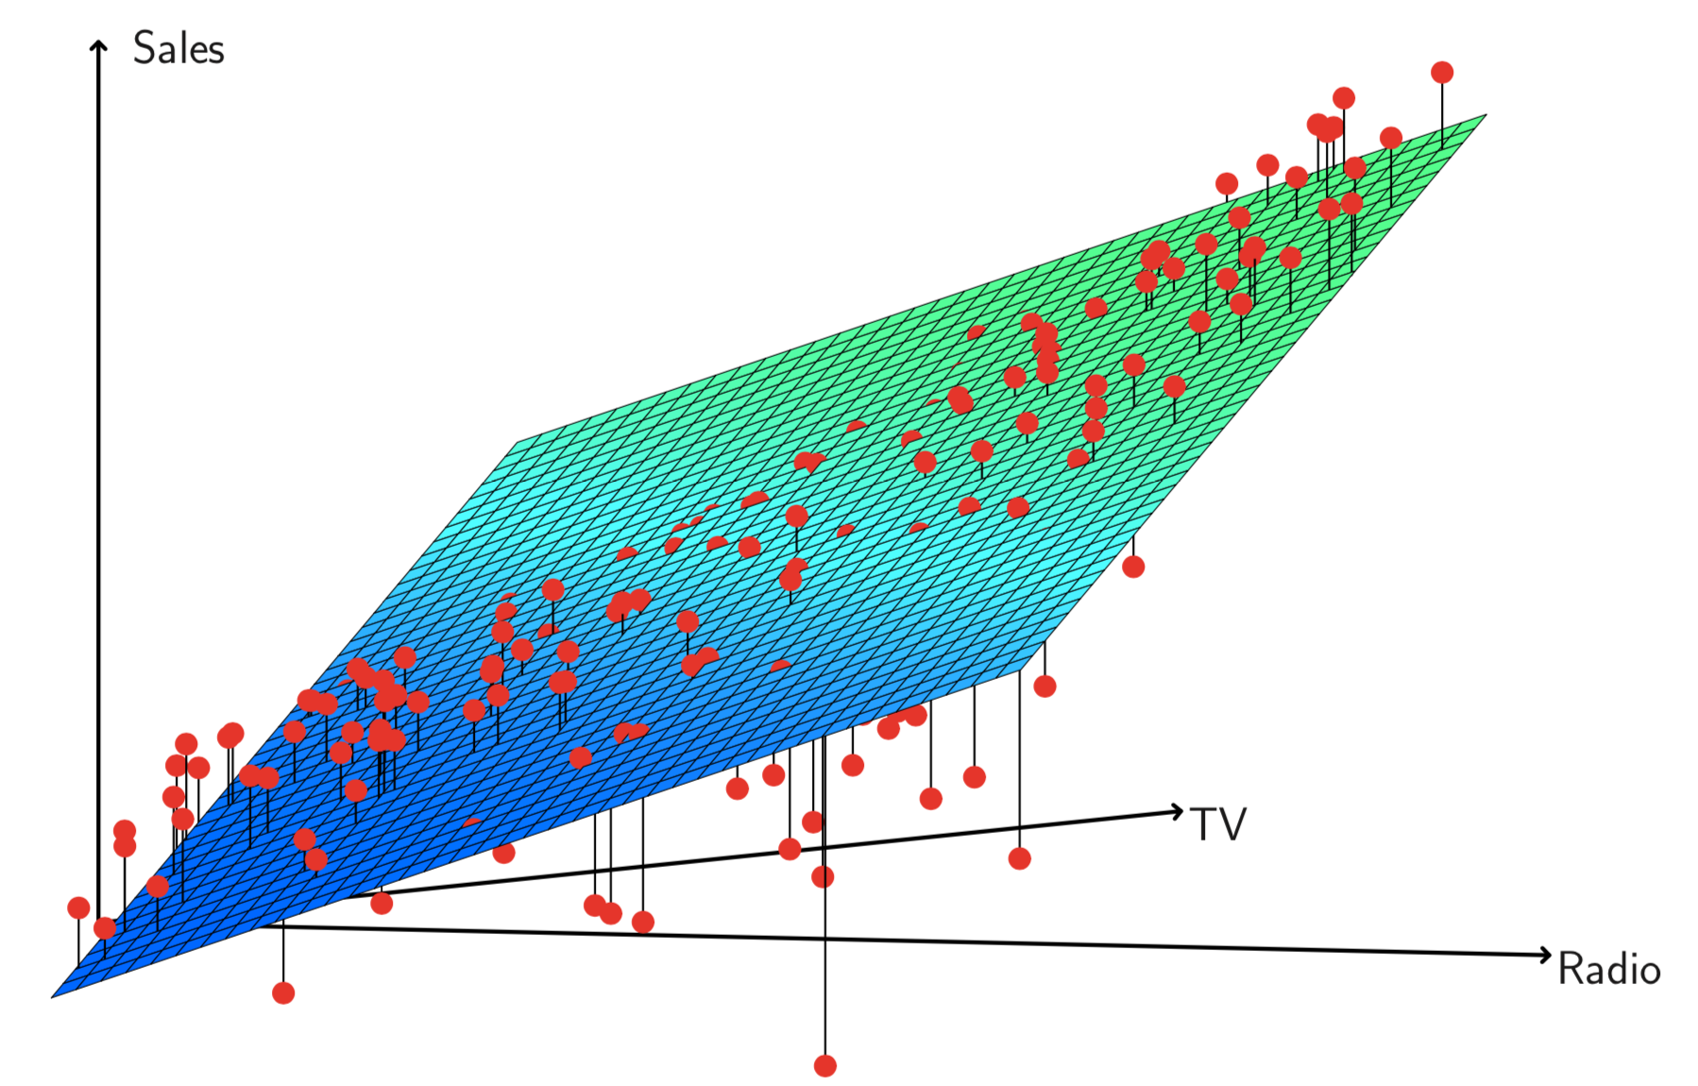
3.2 Multiple Linear Regression
Example: advertising data
18

Slide 19
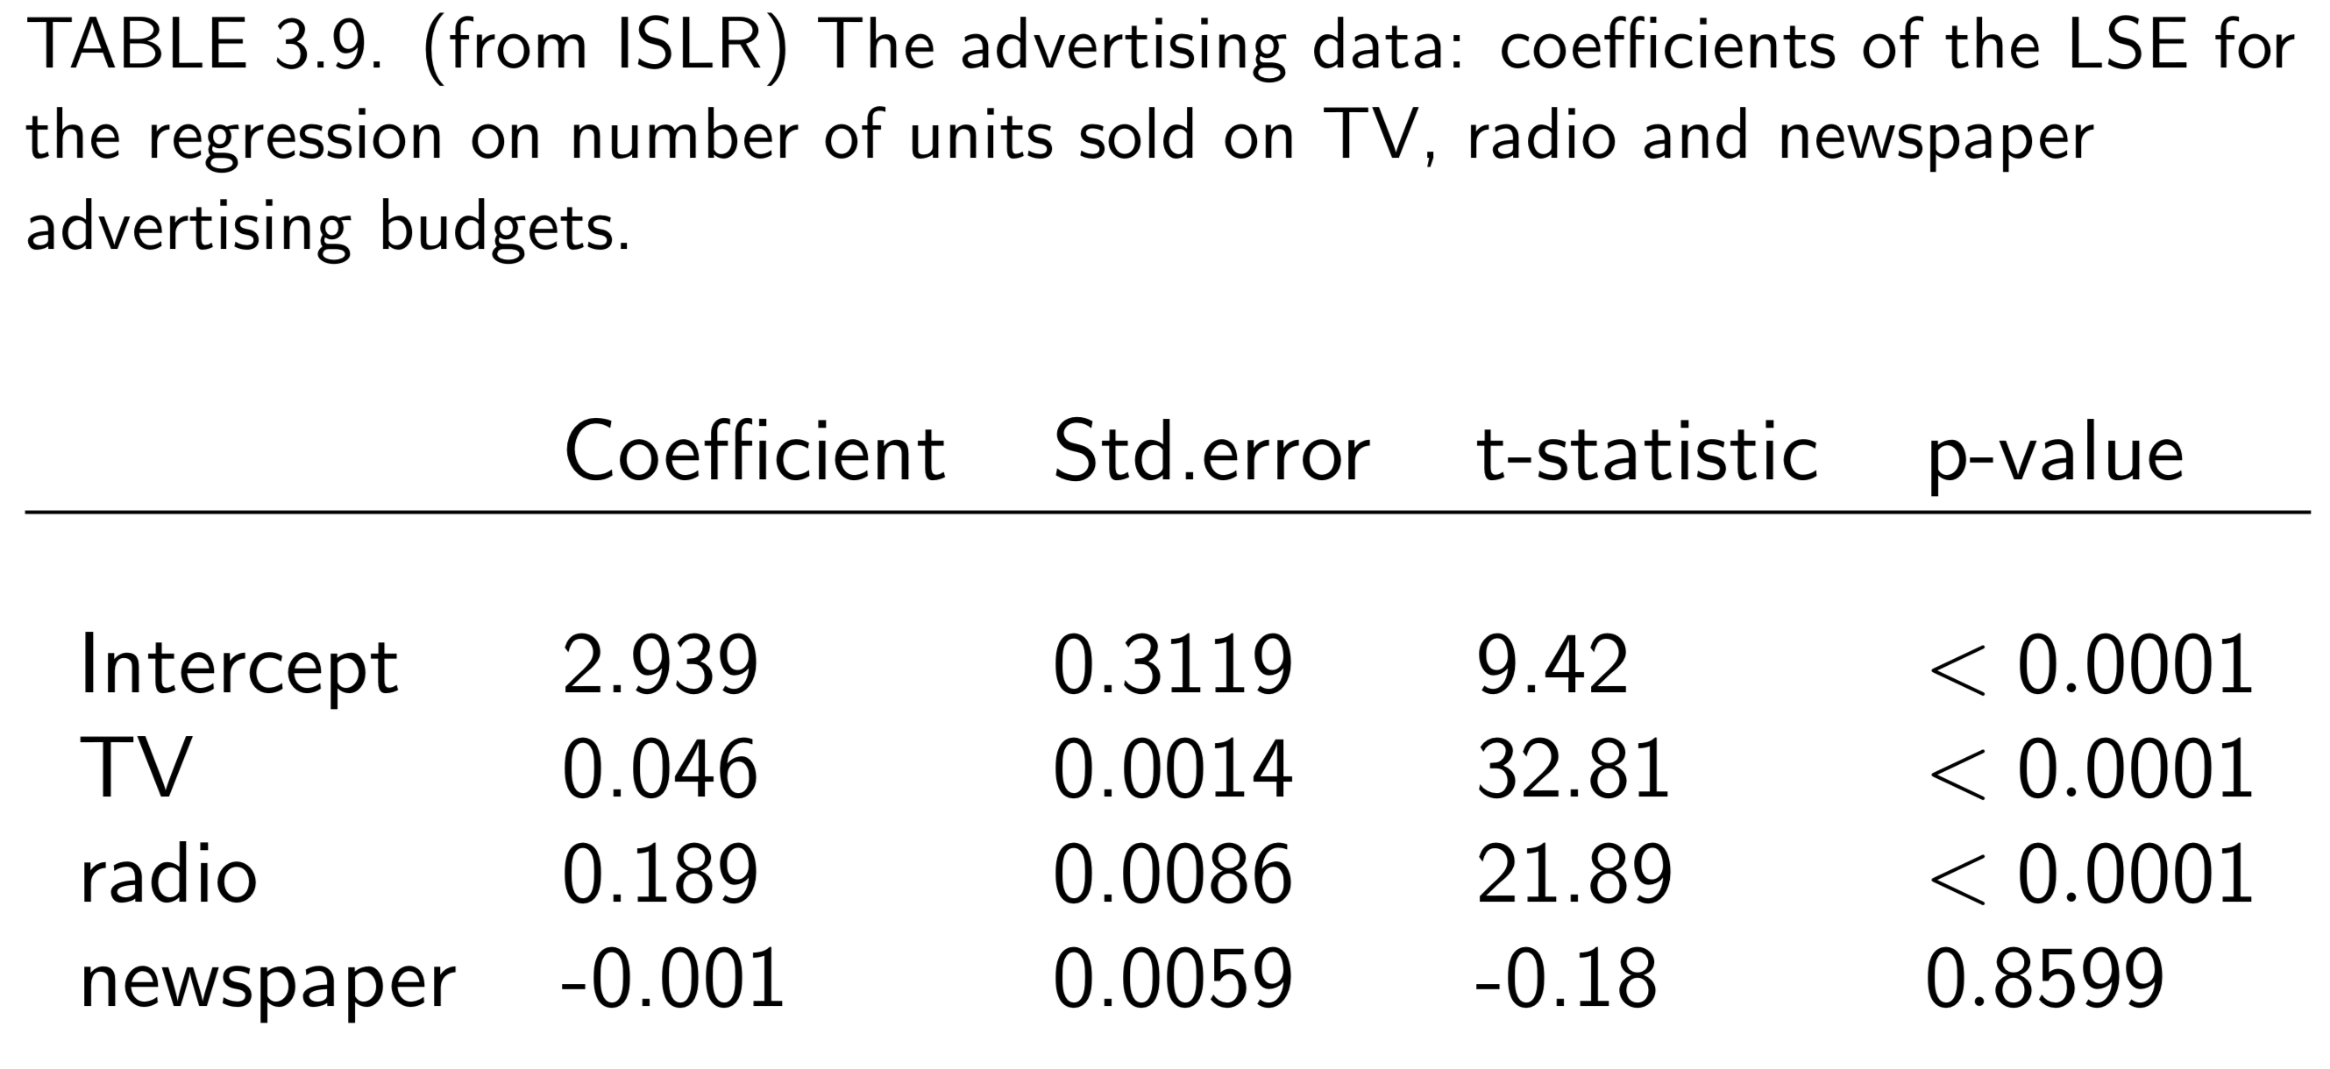
3.2 Multiple Linear Regression
Example: advertising data
Inference provided by R
19

Slide 20
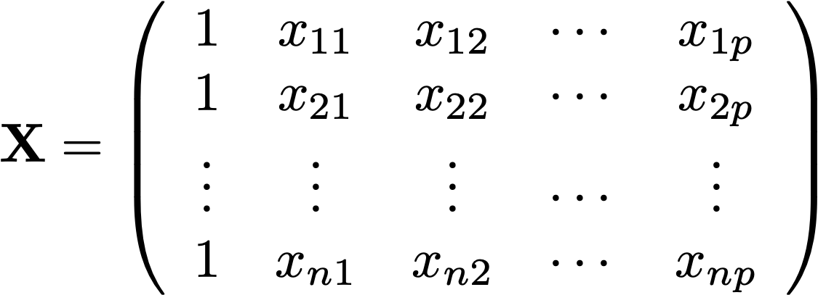
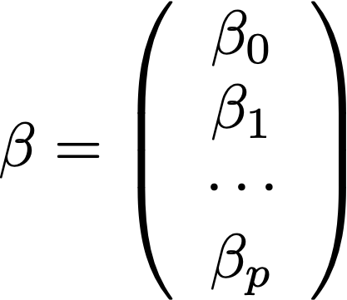
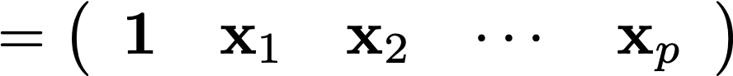
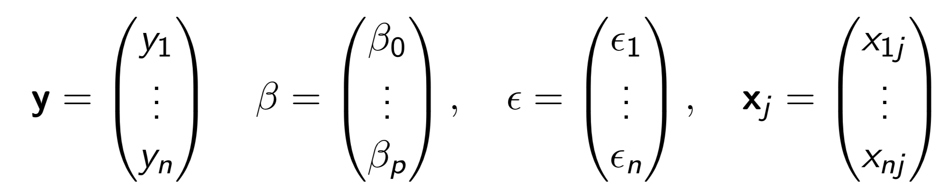
3.2 Multiple Linear Regression
Matrix Notation
In this chapter, we write
Then
20

Slide 21
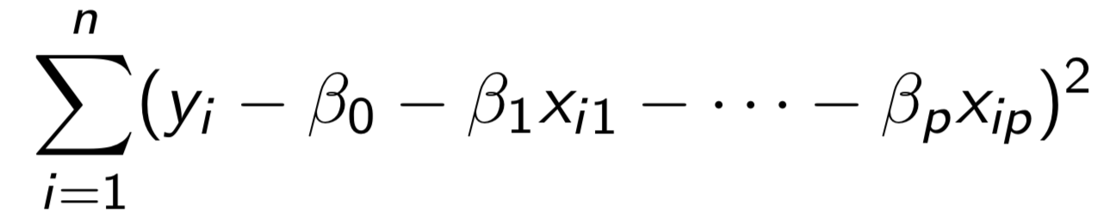
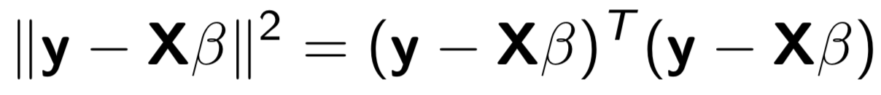
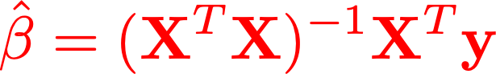
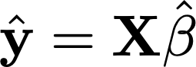
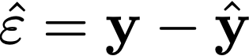
3.3 Least Squares Estimation
The least squares criterion is to minimize the sum of squares
Using matrix algebra, it is equivalently written as
By the first order optimality condition (zeroing the gradient), the LSE of is
Fitted value
Residual
21

Slide 22
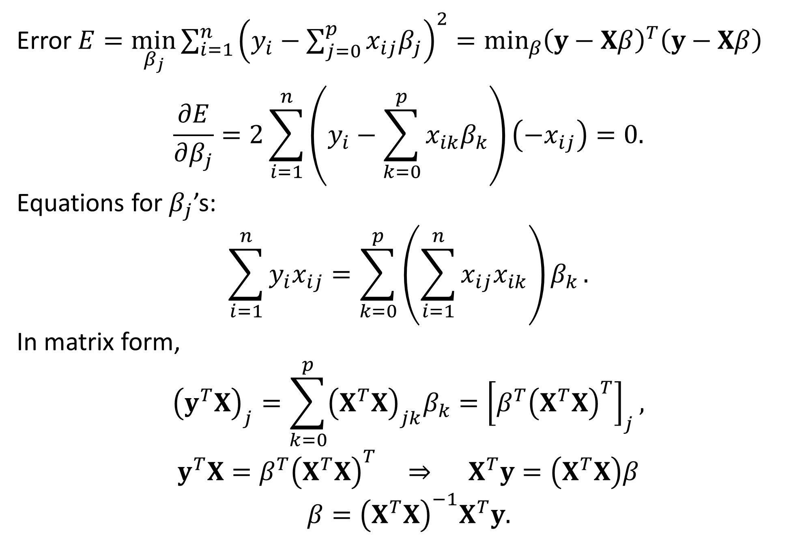

Derivation of $\hat{β}$
Error $E=\min_{β_{j}}{\sum_{i=1}^{n}{{\left(y_{i}−\sum_{j=0}^{p}{x_{ij}β_{j}}\right)}^{2}}}=\min_{β}{{\left(y−Xβ\right)}^{T}\left(y−Xβ\right) }$
$$\frac{∂E}{∂β_{j}}=2\sum_{i=1}^{n}{\left(y_{i}−\sum_{k=0}^{p}{x_{ik}β_{k}}\right)}\left(−x_{ij}\right)=0.$$
Equations for $β_{j}$’s:
$$\sum_{i=1}^{n}{y_{i}x_{ij}}=\sum_{k=0}^{p}{\left(\sum_{i=1}^{n}{x_{ij}x_{ik}}\right)β_{k}}.$$
In matrix form,
$${\left(y^{T}X\right)}_{j}=\sum_{k=0}^{p}{{\left(X^{T}X\right)}_{jk}β_{k}}={\left[β^{T}{\left(X^{T}X\right)}^{T}\right]}_{j},$$
$$y^{T}X=β^{T}{\left(X^{T}X\right)}^{T} ⇒ X^{T}y=\left(X^{T}X\right)β$$
$$β={\left(X^{T}X\right)}^{−1}X^{T}y.$$

Slide 23
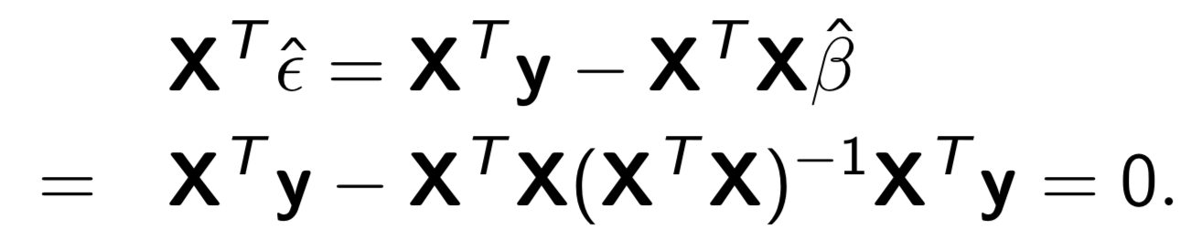
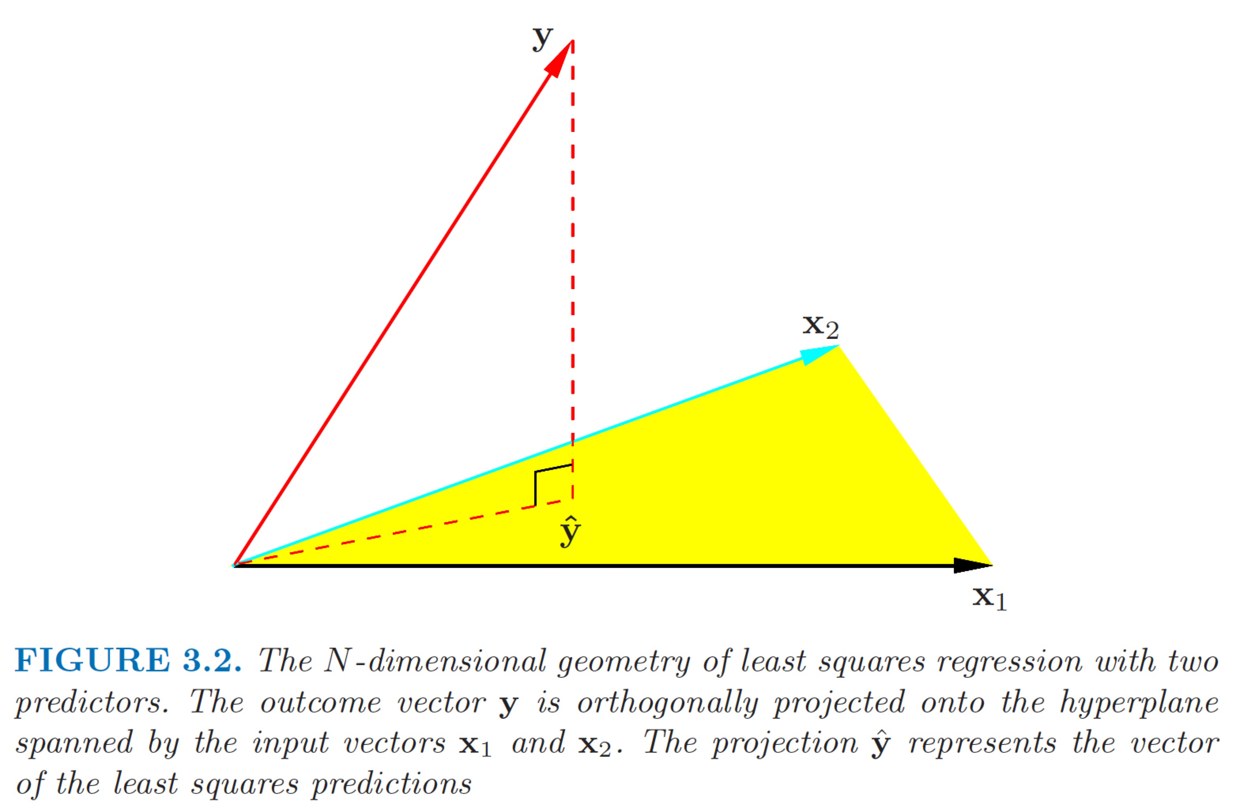
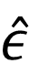
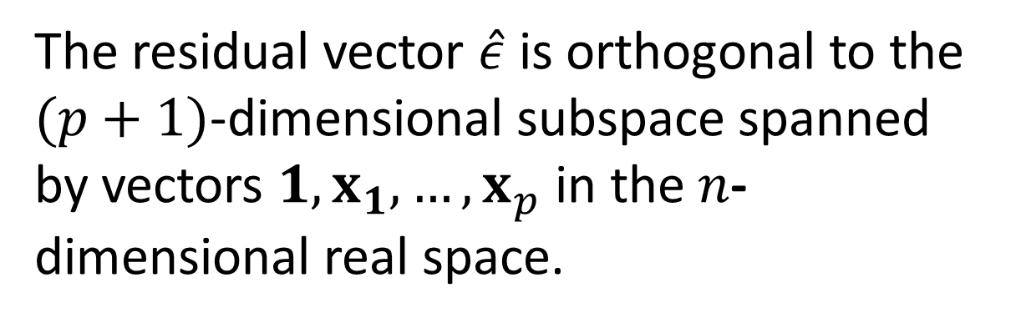
3.3 Least Squares Estimation
orthogonal
Orthogonality of residual and covariates
Input Space
The residual vector $\hat{ε}$ is orthogonal to the $(p+1)$-dimensional subspace spanned by vectors $1, x_{1},…, x_{p}$ in the $n$-dimensional real space.
$$\hat{ε}$$
input space
23

Slide 24
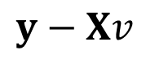
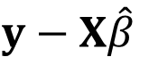

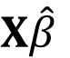
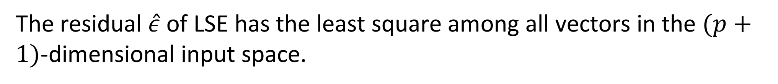
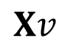
3.3 Least Squares Estimation
orthogonal
Orthogonality of residual and covariates
Least Square Property
The orthogonality of $\hat{ε}$ to the subspace spanned by $1, x_{1},…, x_{p}$ can be used to verify the least square property of $\hat{β}$.
The residual $\hat{ε}$ of LSE has the least square among all vectors in the $(p+1)$-dimensional input space.
$$y−Xv$$
$$y−X\hat{β}$$
$$X\hat{β}$$
$$Xv$$
24

Slide 25
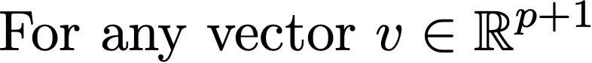
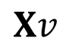
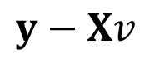



3.3 Least Squares Estimation
orthogonal
Orthogonality of residual and covariates
Proof of LSE
$$={\left\|y−X\hat{β}\right\|}^{2}−2{\left(y−X\hat{β}\right)}^{T}X\left(v−\hat{β}\right)+{\left\|X\left(v−\hat{β}\right)\right\|}^{2}$$
Note that the cross term vanishes because ${\left(y−X\hat{β}\right)}^{T}X={\hat{ε}}^{T}X=0.$ Thus
$${\left\|y−Xv\right\|}^{2}={\left\|y−X\hat{β}\right\|}^{2}+{\left\|X\left(v−\hat{β}\right)\right\|}^{2}≥{\left\|y−X\hat{β}\right\|}^{2}.$$
$$y−Xv$$
$$y−X\hat{β}$$
$$X\hat{β}$$
$$Xv$$
25

Slide 26



3.3 Least Squares Estimation
orthogonal
Orthogonality of residual and fitted values
The fitted values are orthogonal to the residuals, i.e., $\hat{y}$ is orthogonal to $y−\hat{y}$ or
$${\hat{y}}^{T}\left(y−\hat{y}\right)=0.$$
This implies
$${\left\|y\right\|}^{2}={\left\|\hat{y}\right\|}^{2}+{\left\|y−\hat{y}\right\|}^{2},$$
resembling the Pythagorean theorem.
$$y−\hat{y}$$
26

Slide 27


Derivation of ${\hat{y}}^{T}\left(y−\hat{y}\right)=0$
In matrix form,
$${\hat{y}}^{T}\hat{y}={\left(X\hat{β}\right)}^{T}\left(X\hat{β}\right)$$
$$={\left[X{\left(X^{T}X\right)}^{−1}X^{T}y\right]}^{T}X{\left(X^{T}X\right)}^{−1}X^{T}y$$
$$=\left[y^{T}X{\left(X^{T}X\right)}^{−1}X^{T}\right]X{\left(X^{T}X\right)}^{−1}X^{T}y$$
$$=y^{T}X{\left(X^{T}X\right)}^{−1}\left(X^{T}X\right){\left(X^{T}X\right)}^{−1}X^{T}y$$
$$=y^{T}X{\left(X^{T}X\right)}^{−1}X^{T}y$$
$$=y^{T}X\left[{\left(X^{T}X\right)}^{−1}X^{T}y\right]$$
$$=y^{T}X\hat{β}$$
$$=y^{T}\hat{y}.$$
Therefore,
$$\left(y^{T}−{\hat{y}}^{T}\right)\hat{y}=0,$$
$${\hat{y}}^{T}\left(y−\hat{y}\right)=0.$$

Slide 28



3.3 Least Squares Estimation
Projection matrix (to the input space)
LSE
Residual
28

Slide 29
3.3 Least Squares Estimation
Projection matrix
29

Slide 30




3.3 Least Squares Estimation
Properties of projection matrix
All eigenvectors associated with eigenvalue 1 form a space, say $ℒ_{1}.$
$$ℒ_{0}$$
Those with eigenvalue 0 form the orthogonal space, $ℒ_{0},$ of $ℒ_{1}.$
$$ℒ_{1}$$
30

Slide 31

Derivation of Idempotence
In matrix form,
$$H^{2}=\left[X{\left(X^{T}X\right)}^{−1}X^{T}\right]\left[X{\left(X^{T}X\right)}^{−1}X^{T}\right]$$
$$=X{\left(X^{T}X\right)}^{−1}\left(X^{T}X\right){\left(X^{T}X\right)}^{−1}X^{T}$$
$$=X{\left(X^{T}X\right)}^{−1}X^{T}$$
$$=H.$$

Slide 32

MSDM 5054
Dr. Dong XIA
3.4 Statistical Properties of LSE
Model assumptions
General linear regression model
Assumptions
32
Chapter 3. Linear Regression

Slide 33



3.4 Statistical Properties of LSE
Theorem of LSE
Theorem of Residual
Chi-squared distribution
$$\frac{{\left({\hat{β}}_{j}−β_{j}\right)}^{2}}{s^{2}c_{jj}}\sim F_{1,n−p}$$
F distribution
33

Slide 34


Chi-Squared Distribution
The $χ^{2}$-distribution is the distribution of a sum of the squares of $k$ independent standard normal random variables.

Slide 35


F Distribution
$F_{d_{1},d_{2}}$is the distribution of
$$X=\frac{S_{1}/d_{1}}{S_{2}/d_{2}}$$
where $S_{1}$ and $S_{2}$ are independent random variables with $χ^{2}$- distributions with respective degrees of freedom $d_{1}$ and $d_{2}$.

Slide 36


Theorem of LSE for $p=1$
$$X=\left(\begin{matrix}1 & x_{1} \\ ⋮ & ⋮ \\ 1 & x_{n}\end{matrix}\right),$$
$$X^{T}X=\left(\begin{matrix}1 & ⋯ & 1 \\ x_{1} & ⋯ & x_{n}\end{matrix}\right)\left(\begin{matrix}1 & x_{1} \\ ⋮ & ⋮ \\ 1 & x_{n}\end{matrix}\right)=\left(\begin{matrix}n & \sum_{i=1}^{n}{x_{i}} \\ \sum_{i=1}^{n}{x_{i}} & \sum_{i=1}^{n}{x_{i}^{2}}\end{matrix}\right)=n\left(\begin{matrix}1 & \overline{x} \\ \overline{x} & \overline{x^{2}}\end{matrix}\right).$$
$${\left(X^{T}X\right)}^{−1}=\frac{1}{n\left(\overline{x^{2}}−{\overline{x}}^{2}\right)}\left(\begin{matrix}\overline{x^{2}} & −\overline{x} \\ −\overline{x} & 1\end{matrix}\right),$$
$$c_{00}=\frac{\overline{x^{2}}}{\sum_{i=1}^{n}{{\left(x_{i}−\overline{x}\right)}^{2}}}=\frac{1}{n}+\frac{{\overline{x}}^{2}}{\sum_{i=1}^{n}{{\left(x_{i}−\overline{x}\right)}^{2}}}, c_{11}=\frac{1}{\sum_{i=1}^{n}{{\left(x_{i}−\overline{x}\right)}^{2}}}.$$
$$Therefore, \frac{{\hat{β}}_{j}−β_{j}}{s\sqrt{c_{jj}}}\sim t_{n−2} as proposed in Section 3.1.$$

Slide 37


3.4 Statistical Properties of LSE
$$cov\left(\hat{β},\hat{ε}\right)=cov\left(Hy, \left(I−H\right)y\right)=0.$$
The vector y is projected to orthogonal subspaces.
Confidence intervals of parameters
37

Slide 38




3.4 Statistical Properties of LSE
Confidence intervals of mean response
Prediction interval
38

Slide 39







3.5 Analysis of Variances (ANOVA)
Decomposition of variances
R-squared
, the total sum of squares, measures the total variability in response
, the sum of squares due to regression or, more precisely, due to the inputs.
, measures the reduction of variability after the regression has been performed.
39

Slide 40


$R^{2}$ Statistic
$SS_{total}={\left\|y−\overline{y}\right\|}^{2}$= inherent amount of variability before the regression is performed
$SS_{reg}={\left\|\hat{y}−\overline{y}\right\|}^{2}$= amount of variability after performing the regression
$SS_{error}=SS_{total}−SS_{reg}$= ${\left\|y−\hat{y}\right\|}^{2}$= amount of variability that is reduced by performing the regression
$$R^{2}=\frac{SS_{total}−SS_{reg}}{SS_{total}}=1−\frac{SS_{reg}}{SS_{total}}.$$
$R^{2}$ measures the ability of the regression to reduce the variability in the data.

Slide 41

3.5 Analysis of Variances (ANOVA)
ANOVA table
41

Slide 42

Hypothesis Testing in ANOVA
Is there relation between covariates and response ? (ANOVA)
Null hypothesis:
$$H_{0}:β_{1}=β_{2}=⋯=β_{p}=0,$$
versus the alternative
$$H_{a}:at least one β_{j} is nonzero.$$
This hypothesis test is performed by computing the $F$-statistic,
$$F=\frac{MS_{reg}}{MS_{error}}=\frac{SS_{reg}/p}{SS_{error}/(n−p−1)}.$$
If $H_{0}$is true, one would expect the $F$-statistic to be close to 1.
If $H_{a}$ is true, we expect $F>1.$
The $p$-value is calculated by the probability that the $F$-statistic is greater than the observed value.

Slide 43


3.5 Analysis of Variances (ANOVA)
More general tests of linear model
We have shown how to test
i.e.,
Rationale of ANOVA
43

Slide 44


3.5 Analysis of Variances (ANOVA)
More general tests of linear model
What if we want to test
i.e.,
44

Slide 45



3.5 Analysis of Variances (ANOVA)
More general tests of linear model
ANOVA in general
45

Slide 46


3.5 Analysis of Variances (ANOVA)
More general tests of linear model
ANOVA in general (cont.)
46

Slide 47
3.7 Superiority of LSE
Why is LSE good ?
Easy computation
Consistency
https://en.wikipedia.org/wiki/Consistent_estimator
Efficiency
https://en.wikipedia.org/wiki/Efficient_estimator
47

Slide 48

Best Linear Unbiased Estimators
Suppose a set of examples is generated by the unobservable parameters $β_{j}$according to
$$y_{i}=\sum_{j=1}^{p}{β_{j}x_{ij}}+ε_{i} ∀i=1, 2, …, n.$$
A linear estimator of $β_{j}$ is a linear combination
$${\tilde{β}}_{j}=a_{1j}y_{1}+⋯+a_{nj}y_{n}.$$
In matrix form, $\tilde{β}=Ay.$
The estimator is unbiased if and only if $E\left({\tilde{β}}_{j}\right)=β_{j}.$
The best linear unbiased estimator (BLUE) is one with the smallest mean squared error among all linear estimators. This is equivalent to $Var\left(\tilde{β}\right)−Var(\hat{β})$ is positive semi-definite for every other linear unbiased estimator $\tilde{β}$.

Slide 49

3.7 Superiority of LSE
Theorem
49

Slide 50

3.7 Superiority of LSE
Proof of Gauss-Markov Theorem
The data generated by the teacher is given by $E\left(y\right)=Xβ.$
The LSE is unbiased because
$$E\left[{\left(X^{T}X\right)}^{−1}X^{T}y\right]={\left(X^{T}X\right)}^{−1}X^{T}Xβ=β.$$
For an arbitrary unbiased linear estimator $\tilde{β}=Ay$, we write $A={\left(X^{T}X\right)}^{−1}X^{T}+D$. Then
$$E\left(\tilde{β}\right)=E\left[{\left(X^{T}X\right)}^{−1}X^{T}y+Dy\right]={\left(X^{T}X\right)}^{−1}X^{T}Xβ+DXβ$$
$$=β+DXβ=β.$$
This implies $DX=0$.
50

Slide 51

3.7 Superiority of LSE
Proof of Gauss-Markov Theorem (cont’d)
$$Var\left(\tilde{β}\right)=Var\left(Ay\right)=AVar\left(y\right)A^{T}=σ^{2}AA^{T}$$
$$=σ^{2}\left[{\left(X^{T}X\right)}^{−1}X^{T}+D\right]{\left[{\left(X^{T}X\right)}^{−1}X^{T}+D\right]}^{T}$$
$$=σ^{2}{\left(X^{T}X\right)}^{−1}+σ^{2}{\left(X^{T}X\right)}^{−1}X^{T}D^{T}+DX{\left(X^{T}X\right)}^{−1}+σ^{2}DD^{T}$$
Since $DX=0$, the cross terms vanish. Therefore,
$$Var\left(\tilde{β}\right)=σ^{2}{\left(X^{T}X\right)}^{−1}+σ^{2}DD^{T}=Var\left(\hat{β}\right)+σ^{2}DD^{T}.$$
Since $DD^{T}$ is positive semidefinite, $\hat{β}$ has the smallest variance.
51

Slide 52

3.8 Assessing the Regression Model
a) Error distribution (normality check)
Non-normality may cause the normality-based inference such as t-test
and F-test being inaccurate
Use graphics, such histogram, boxplot and qqnorm to visualize the the
distribution of the residuals
52

Slide 53

3.8 Assessing the Regression Model
b) Homoscedasticity versus heteroscedasticity
Heteroscedasticity can cause the estimate being not the optimal one .
May be fixed by weighted least squares estimation.
Use scatter plot of residuals against the fitted values to check the
heteroscedasticity (the variance of the errors are not equal).
53

Slide 54

3.8 Assessing the Regression Model
e) Multicollinearity
54

Slide 55
3.8 Assessing the Regression Model
e) Multicollinearity
55

Slide 56




3.9 Variable Selection
Model 1
use all p predictors
Model 2
use only q predictors
q<p
How should we assess which model is better ?
56

Slide 57
3.9 Variable Selection
Variable selection, or more generally, model selection, is an important tool
in minimizing prediction error.
There are substantial research development regarding methods of model
selection.
The aim is to minimize generalization error or expected error.
The naive approach is to exhaust all models. However, with the curse of
dimensionality, this is quickly prohibitive when the number of variables
increase.
More sophisticated methods such as cross validation or
regularization methods, such as LASSO (Tibshirani 1996).
57

Slide 58
3.9 Variable Selection
More inputs do not imply better prediction, particularly if the inputs in the
model are irrelevant with the response.
Moreover, more inputs also imply more danger of overfit, resulting in
small training error but large test error.
Here we introduce more basic and simple methods.
58

Slide 59
3.9 Variable Selection
a) Adjusted R-squared
The R-squared is the percentage of the total variation in response due
to the inputs. The R-squared is commonly used as a measurement of how
good the linear fit is.
However, a model with larger R-squared is not necessarily better than
another model with smaller R-squared!
If model A has all the inputs of model B, then model A’s R-squared will
always be greater than or as large as that of model B.
If model A’s additional inputs are entirely uncorrelated with the response,
model A contain more noise than model B. As a result, the prediction
based on model A would inevitably be poorer or no better.
59

Slide 60




3.9 Variable Selection
a) Adjusted R-squared
Recall that the R-squared is defined as:
The adjusted R-squared, taking into account of the degrees of freedom,
is defined as
With more inputs, the R-squared always increase, but the adjusted R-squared
could decrease since more inputs is penalized by the smaller degree of freedom
of the residuals.
The adjusted R-squared is preferred over the R-squared in evaluating
models.
60

Slide 61


3.9 Variable Selection
c) AIC
AIC stands for Akaike information criterion, which is defined as
AIC aims at maximizing the predictive likelihood. The model with the smallest
AIC is preferred.
61

Slide 62




MSDM 5054
Dr. Dong XIA
3.9 Variable Selection
Recall that our linear model has p covariates, and
62
Chapter 3. Linear Regression

Slide 63

3.9 Variable Selection
c) AIC
The (expected) predictive log-likelihood
63
Chapter 3. Linear Regression

Slide 64

MSDM 5054
Dr. Dong XIA
3.9 Variable Selection
c) AIC
The (expected) predictive log-likelihood
The formula of AIC in general models.
In the special case of linear regression model, it reduces to
64
Chapter 3. Linear Regression

Slide 65
MSDM 5054
Dr. Dong XIA
3.9 Variable Selection
d) BIC
BIC stands for Schwarz’s Bayesian information criterion, which is defined as
for a linear model with p inputs. Again, the model with the smallest
BIC is preferred.
The derivation of BIC results from Bayesian statistics and has Bayesian
interpretation. It is seen that BIC is formally similar to AIC. The BIC penalizes
more heavily the models with more number of inputs.
65
Chapter 3. Linear Regression

